Slide 1
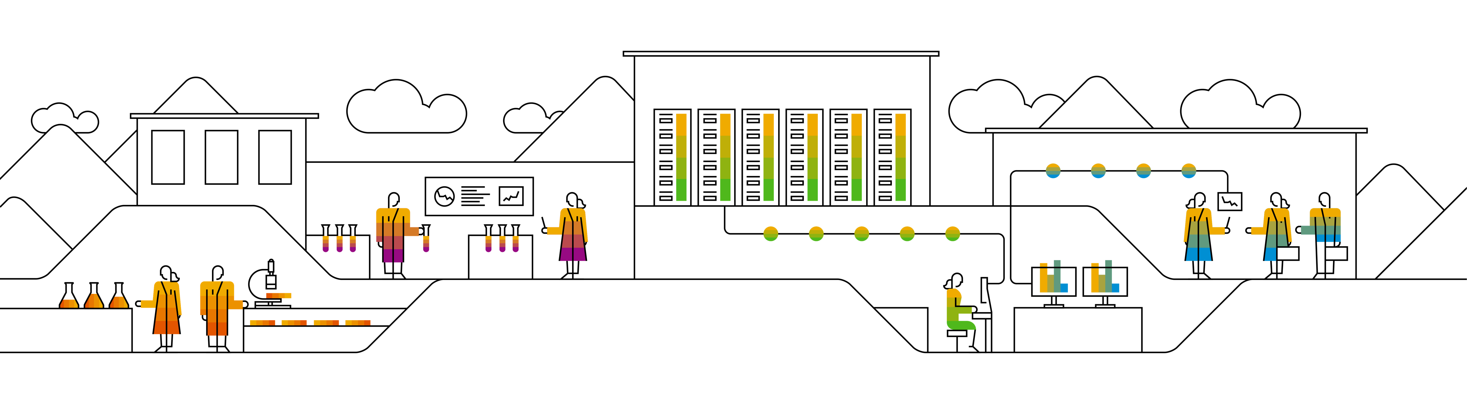
Spring Boot Software Academy Lunch Talk
Marcelo Gomes, Software Developer, Software Academy

Slide 2
Agenda
Spring Framework Ecosystem
How create a simple Java Application using SPRINT INITIALIZR
How create a simple microservice
A simple CRUD web application
How use Security and Metrics
How use different Embedded Web Servers
How use different SQL databases
A simple demo using NoSQL database with MongoDB
References

Slide 3
Notes:
Spring Framework Ecosystem:
1. Introduce Spring Framework Ecosystem:
1.1. Spring is a powerful open source framework for Java Platform.
1.2. Spring is a complete and modular framework for developing enterprise applications in Java.
1.3. Spring Framework can be used for all layer implementations for an application or can be used for develop a specific layer.
2. Comment about the problems in Spring Framework Ecosystem:
2.1. Spring is a large framework and its understanding can be hard.
2.2. It’s necessary a lot of steps to create an application and this can reduce the development productivity.
2.3. It’s necessary multiple configuration steps, multiple builds and deploy steps.
2.4. In many cases the dependency injection is realized using configuration files in XML format. The maintenance of a lot of XML files can be a hard process.
3. Introduce Spring Boot
3.1. The project Spring Boot (or Boot simply) is more a framework the Spring ecosystem. Was launched with the Spring Framework 4.0.
3.2. Spring Boot make use of all Spring ecosystem and bring more productivity for the developer.
3.3. Spring Boot decrease the time that the developers spend to start the implementation of new projects.
3.4. Spring Boot makes easy and fast the process to create an application.
4. Start the Demo

Slide 4
Starting our demo!

Slide 5
Creating a Java Application using SPRING INITIALIZR
Web Services – SPRING INITIALIZR

Slide 6
References
Getting Started with Spring Boot by Josh Long
https://www.youtube.com/watch?v=sbPSjI4tt10&t=371s
Spring Boot Quick Start (Java Brains Course)
https://www.youtube.com/watch?v=msXL2oDexqw&list=PLqq-6Pq4lTTbx8p2oCgcAQGQyqN8XeA1x
Thymeleaf
https://www.thymeleaf.org/
Bootstrap Classes Reference
https://www.w3schools.com/bootstrap/bootstrap_ref_all_classes.asp
MongoDB Manual
https://docs.mongodb.com/manual/introduction/
Spring Boot Embedded Servlet Containers – Tomcat vs. Jetty vs. Undertow
https://examples.javacodegeeks.com/enterprise-java/spring/tomcat-vs-jetty-vs-undertow-comparison-of-spring-boot-embedded-servlet-containers/
Notes:
Data is growing very fast and Relational databases is not enough
Relational database doesn`t work very well with unstructured data
MongoDB:
Good:
MongoDB is a document oriented database, real time processing, works very well with large size of data, is very flexible, very fast, higher availability, no schemas and you can store different types of documents
MongoDB scales horizontally (sharding) – Very easy and with low cost
MongoDB makes use of JSON
MongoDB support Stored Procedures, but in MongoDB Stored Procedures are written in JavaScript
MongoDB works very well with unstructured data such as videos, emails, audio files, web pages, social media, etc
MongoBD together with Hadoop is a complete Big Data solution
Hadoop: open source implementation, MapReduce technique used by Google, Analytical purpose, not for real time processing,
Bad:
MongoDB is not the best option if you application works with complex transactions
MongoDB doesn`t work very well with transactions if you need to update more than one document or collection per user request
There is not triggers in MongoDB
MongoDB needs more storage than other popular database
MongoDB doesn’t automatically clean up the disk space, is necessary restart or to be done manually

Slide 7
Thank you!

